Slide 1

Jamil Garzuzi
GIS Senior Developer and System architecture jamil.garzuzi@gmail.com
GIS Awareness Week
by AIRC × Ecologik
November 21, 2026
The Power of GIS
Mapping location, data and insight

Slide 2
From paper layers to real-time cloud intelligence.
1854
The Cholera Map: John Snow maps cholera cases in London, overlaying water pump locations onto a city grid to identify the source of the outbreak—founding spatial analysis using paper and ink.
1960s
The Birth of CGIS: Dr. Roger Tomlinson drafts the Canada Geographic Information System, creating the first computerized GIS to measure and manage land inventory.
1969
Esri Founded: Jack and Laura Dangermond establish the Environmental Systems Research Institute (Esri), pioneering mapping software and computer spatial theory.
1980s
Commercialization: Software like ARC/INFO launches, moving GIS from mainframe computers to desktop workstations for governments and private enterprise.
1990s
Accessibility & Web: Digital data formats standardize, open-source initiatives (like the beginnings of QGIS) emerge, and the internet paves the way for web mapping.
2000s to Present
Cloud & Big Data: Cloud-based platforms (ArcGIS Online, Google Earth Engine) emerge, enabling real-time smartphone data collection, satellite analytics, and live operational dashboards.

Slide 3
GIS (Geographic Information System)
A framework for gathering, managing, and analyzing spatial data to uncover patterns and relationships.
Spatial Data: information that identifies the geographic location and characteristics of natural or constructed features on Earth.
Attribute Data:Non-spatial information appended to a location, answering the question "What is at this place?" (e.g., a pipe's diameter or a city's population).
Georeferencing: The process of assigning real-world coordinates (latitude and longitude) to a map or dataset.

Slide 4
GIS: The Power of Spatial Intelligence
Linking location with data to reveal patterns, optimize operations, and drive smarter choices.
Data Integration: Blends scattered datasets into a single, cohesive stack of visual map layers.
Operational Efficiency: Lowers costs and saves time through precise route and asset optimization.
Informed Decisions: Pinpoints ideal locations for infrastructure by analyzing demographics and geography.
Risk Mitigation: Simulates natural disasters and future trends to build resilient, long-term plans.
Clear Communication: Translates complex spatial mathematics into intuitive, scannable visual stories.

Slide 5

Live Demo Web sites
https://wsdot.com/travel/real-time/map/?utm_source=chatgpt.com
https://earthquake.usgs.gov/earthquakes/map/?utm_source=chatgpt.com
https://sfdlive.com/utm_source=chatgpt.com
https://www.dera.earth/
https://www.windy.com/-Waves-waves?waves,32.080,34.781,5

Slide 6
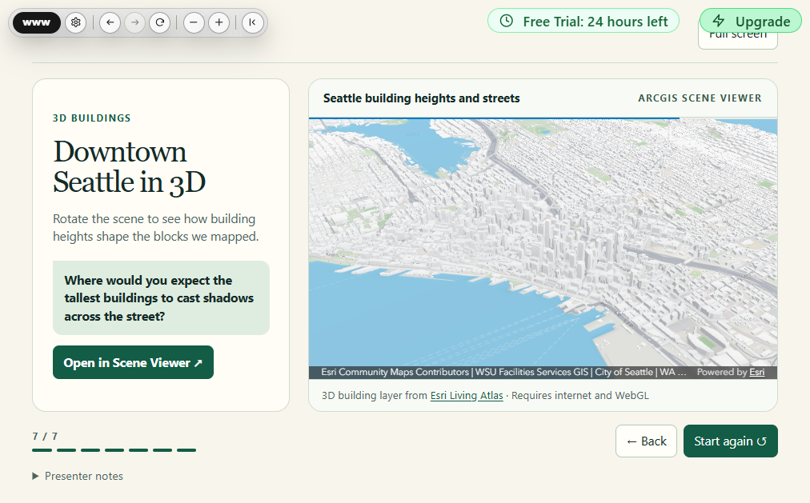

Slide 7
Jamil Garzuzi
GIS Senior Developer and System architecture jamil.garzuzi@gmail.com
GIS Awareness Week
by AIRC × Ecologik
November 21, 2026
Thank you
for listening — questions are welcome

